Slide 1


Identifying Mood Disorders in Patients
Analysis by Group 2, Presentation by Enrique Rosen
Notes:
Hello, my name is Enrique Rosen, and today ill be talking you through our process of identifying mood disorders in patients

Slide 2
Our Problem:
Bright-Hope need to diagnose mood disorders in patients
Available to us is a dataset containing self-reported survey results of 240 patients, along with the diagnosis given to them
Our goal is to use machine learning to leverage this data to create our own predictive model to assess mood disorder based on survey results

Slide 3
Survey Data:
An ID number for each patient
Frequency of Sadness, Euphoria, Exhaustion, and Sleeplessness
A Yes/No response to experiencing Mood Swings, Suicidial Thoughts, Anorexia, Disobedience, Justifying Behaviors, Moving on, Nervous Breakdowns, Admission of Mistakes, and Overthinking
A 1 to 10 scale of Sexual Activity, Concentration, and Optimism
Their diagnosis

Slide 4
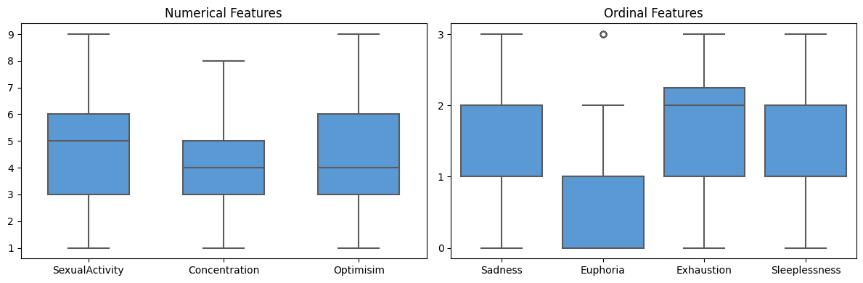
Data Exploration:
Notes:
Sexual activity is centered at about 5 our of 10, Concentration and optimism at 4. Sadness and sleeplessness are hovering between seldom and sometimes, Euphoria is seldom, and Exhaustion is sometimes

Slide 5
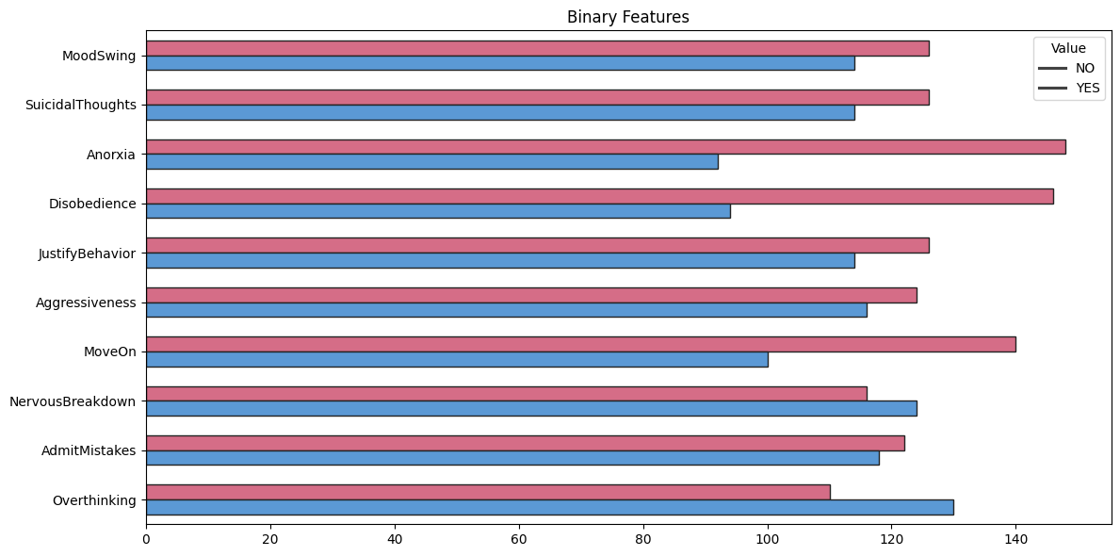
Notes:
We find relatively equal distributions of our binary variables, hovering from around 40 to 55% reported “yes”

Slide 6
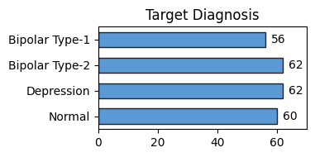
Notes:
As we can see, there is a relatively even split between all 4 diagnoses

Slide 7
Model Building: We assess 4 possible models in order to predict our Diagnosis
K-Nearest Neighbors Classifier
Decision Tree Classifier
Random Forest Classifier
Extra Trees Classifier
Notes:
We assess 4 possible models in order to predict our Diagnosis: we will continue with the one that performs the task of classification the best

Slide 8

Initial Results:
Accuracy of KNN: 80.0%
Accuracy of Decision Tree: 96.7%
Accuracy of Random Forest: 96.7%
Accuracy of Extra Tree: 96.7%
There is no obvious best model, so we must fine-tune our models for performance
Notes:
Building a basic version of each model, we test its accuracy on a set of training data. K nearest neighbors performed the worst with an accuracy of only 80%, while the rest excelled at 96.7% accuracy

Slide 9
Improving our models
We perform a grid search for each model to tune their respective hyperparameters, hopefully improving performance
This may produce minor improvements, major improvements, or even no Improvements at all

Slide 10
To perform more robust comparison, the following metrics will be used to assess performance:
Performance Statistics:
Accuracy
Precision
Recall (Sensitivity)
Specificity
F1 Score
K-Fold Cross Validation
Notes:
K-fold cross validation is the most computationally intensive, and may give the most insightful results

Slide 11
Tuned Hyperparameters:
For the KNN model, the parameter is set as follows: number of neighbors is 2.
"For the Decision Tree model, the parameters are set as follows: criterion is 'gini', maximum depth is unlimited, minimum samples per leaf is 1, and minimum samples required to split is 2.
For the Random Tree model, the parameters are set as follows: maximum depth is unlimited, minimum samples per leaf is 1, minimum samples required to split is 2, and the number of estimators is 50.
For the Extra Tree model, the parameters are set as follows: maximum depth is unlimited, minimum samples per leaf is 1, minimum samples required to split is 2, and the number of estimators is 50

Slide 12
Performance Statistics:
 | Model | Accuracy | Precision | Recall | Specificity | F1 Score
0 | KNN | 0.950000 | 0.960565 | 0.946429 | 0.982249 | 0.844444
1 | DecisionTree | 0.966667 | 0.968750 | 0.973684 | 0.989130 | 0.922222
2 | RandomForest | 0.966667 | 0.968750 | 0.973684 | 0.989130 | 0.950000
3 | ExtraTree | 0.966667 | 0.968750 | 0.973684 | 0.989130 | 0.961111
Notes:
Tuning the hyperparameters, the accuracy of KNN was improved to 95%, but still below the other models whos accuracy remains unchanged. ExtraTree appears the best with the highest f1 score, and no statistics lower than any other model

Slide 13
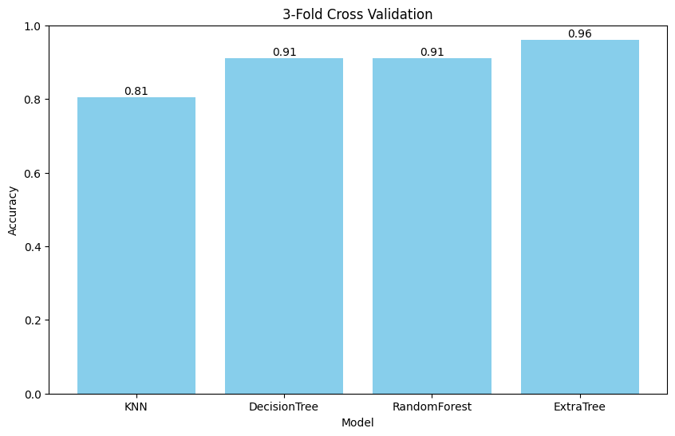
Notes:
Now we asses the accuracy of each model with 3-fold cross validation, as we can see here, Extra Tree still performs the best at 96%

Slide 14

Conclusions and Recommendations:
Performing better or equal to all other models in every relevant statistic, our hyperparameter-tuned Extra Tree Classification model was the clear winner
It diagnosed patients correctly based on given survey data 96.7% of the time, with a precision of 96.9%, Sensitivity of 97.4%, specificity of 98.9%,
Doctors can use this model in tandem with their patient analysis to better diagnose patients, improving the quality of their care at Bright-Hope

Slide 15
Limitations of Analysis
Only 240 records were part of the data set, increasing this could improve model performance
Errors in data set: Any errors in inputting values, or especially putting the wrong diagnosis in could drastically affect our model’s performance
The Model doesn’t account for variables outside of dataset: if someone self-reported as being awake nocturnally, our model wouldn’t be influenced by it even if it is a factor

